Slide 1
Dash Enterprise
Core components
Figure Reference
ALL EXAMPLES REPO
IPython Notebooks
Style Sheets
Scientific charts
Ideas/Inspiration

Slide 2
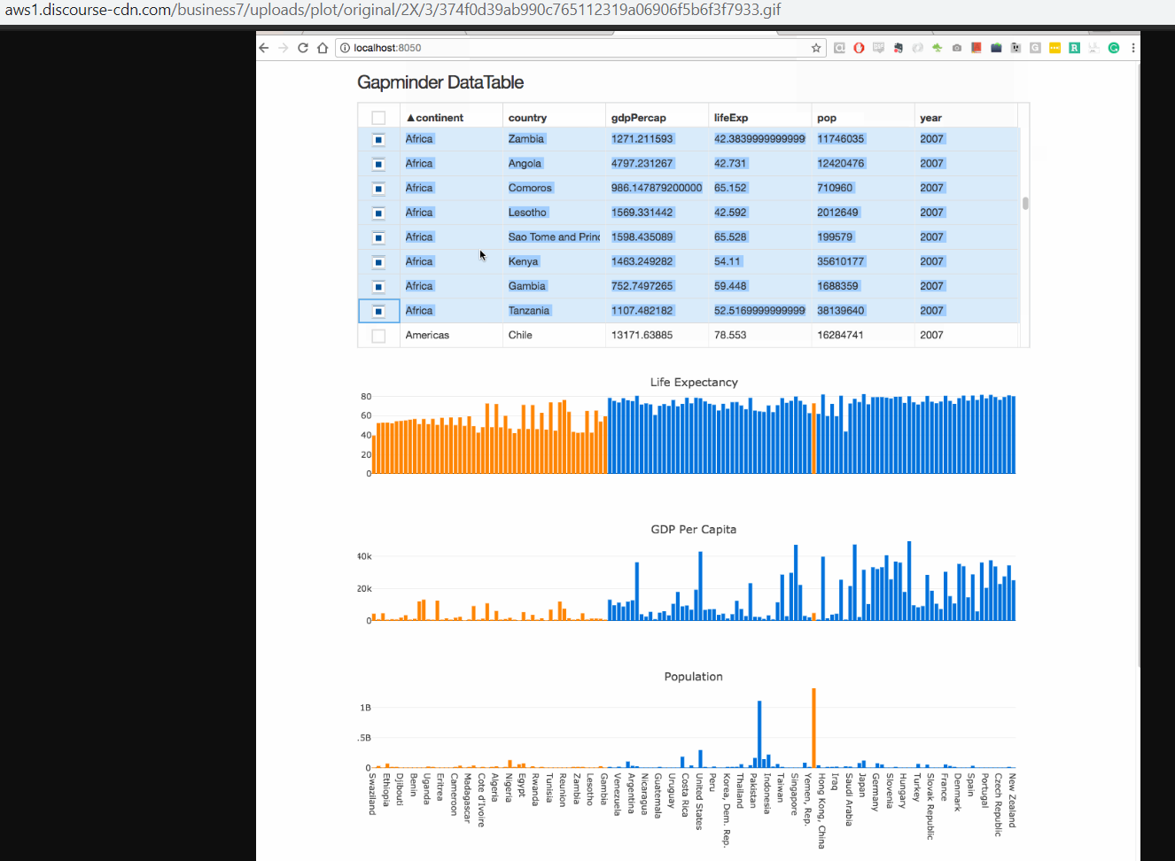
https://community.plot.ly/t/display-tables-in-dash/4707/42

Slide 3
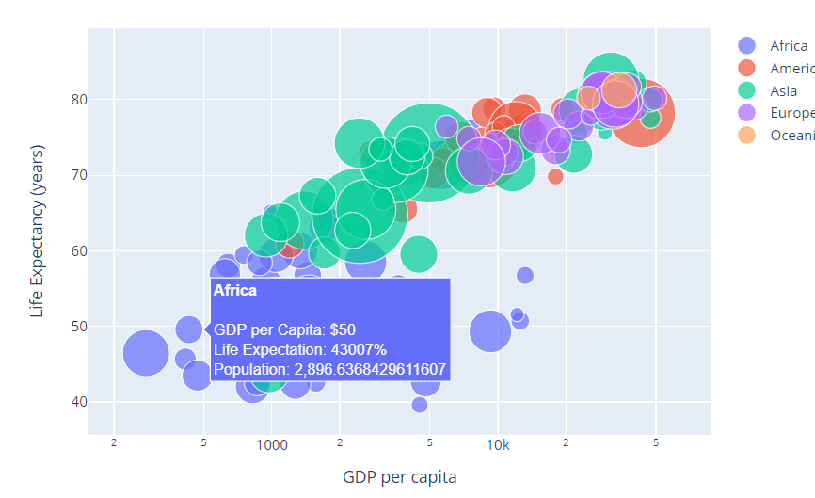
- https://plot.ly/python/text-and-annotations/ - https://plot.ly/python/hover-text-and-formatting/

Slide 4
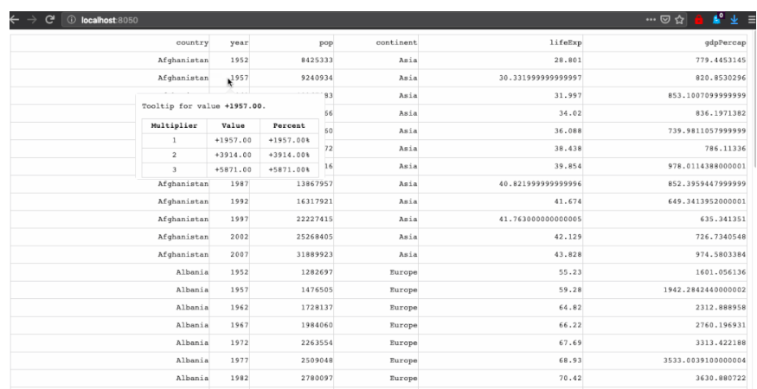
[Data Tables(https://community.plot.ly/t/dash-datatable-tooltips/6327/2) - https://dash.plot.ly/datatable - Will not work on a plot I think

Slide 5
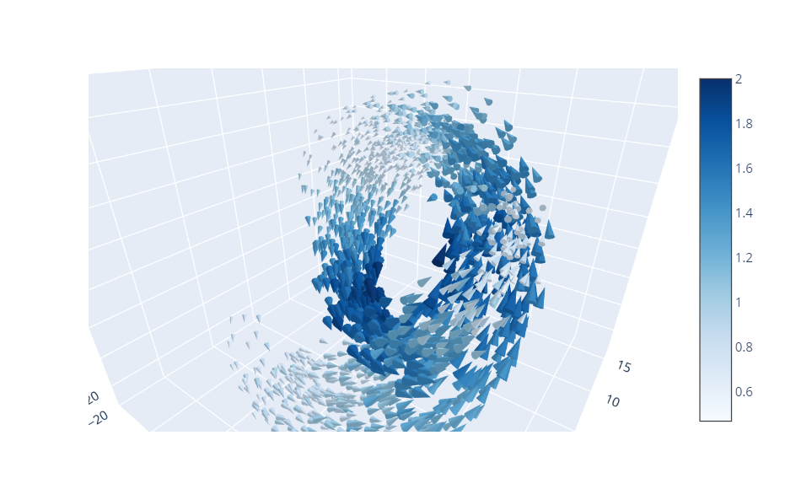
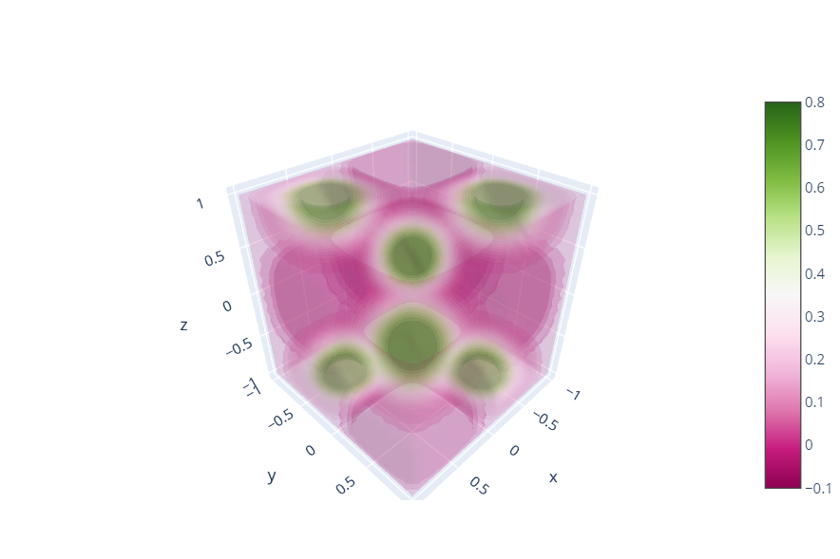
3D charts - Cone - Volume

Slide 6
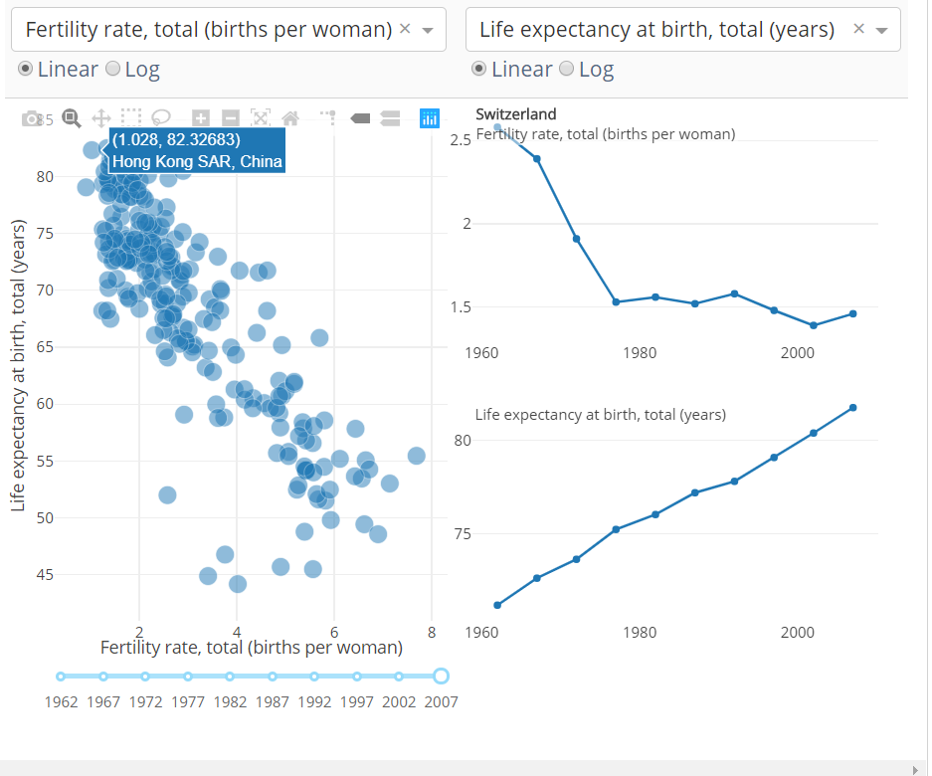
Crossfilter Recipe - Selection affects other plots

Slide 7
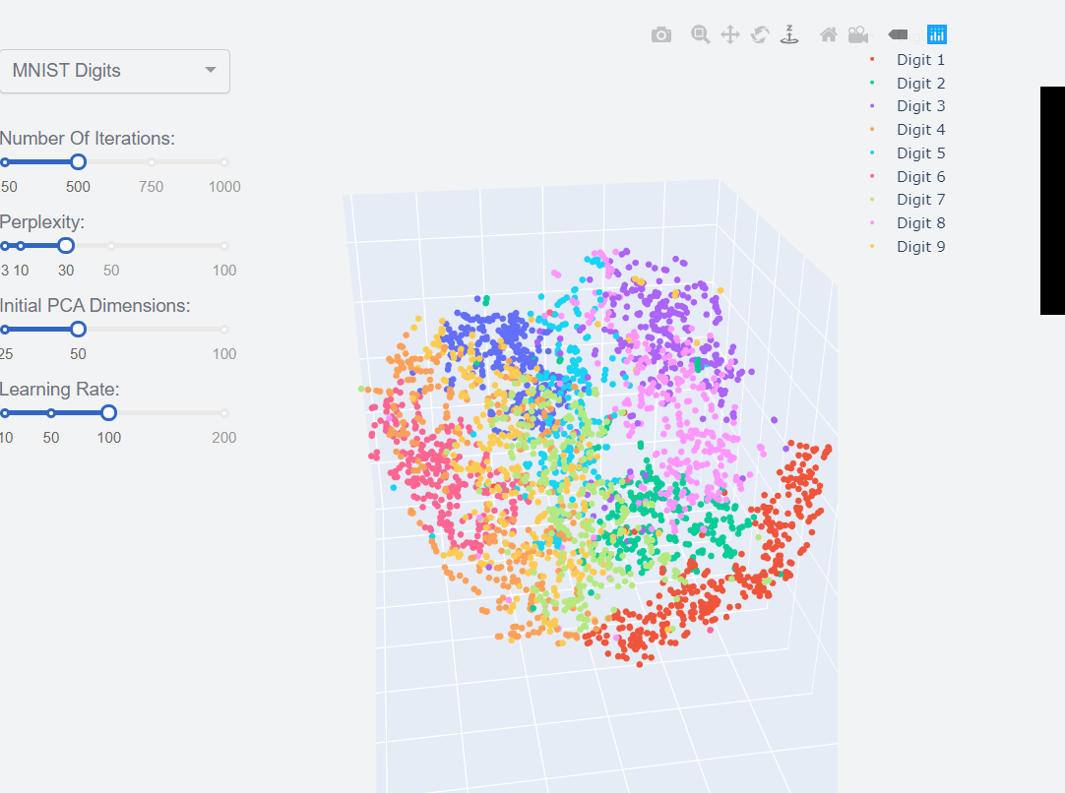
t-SNE 3D vis

Slide 8
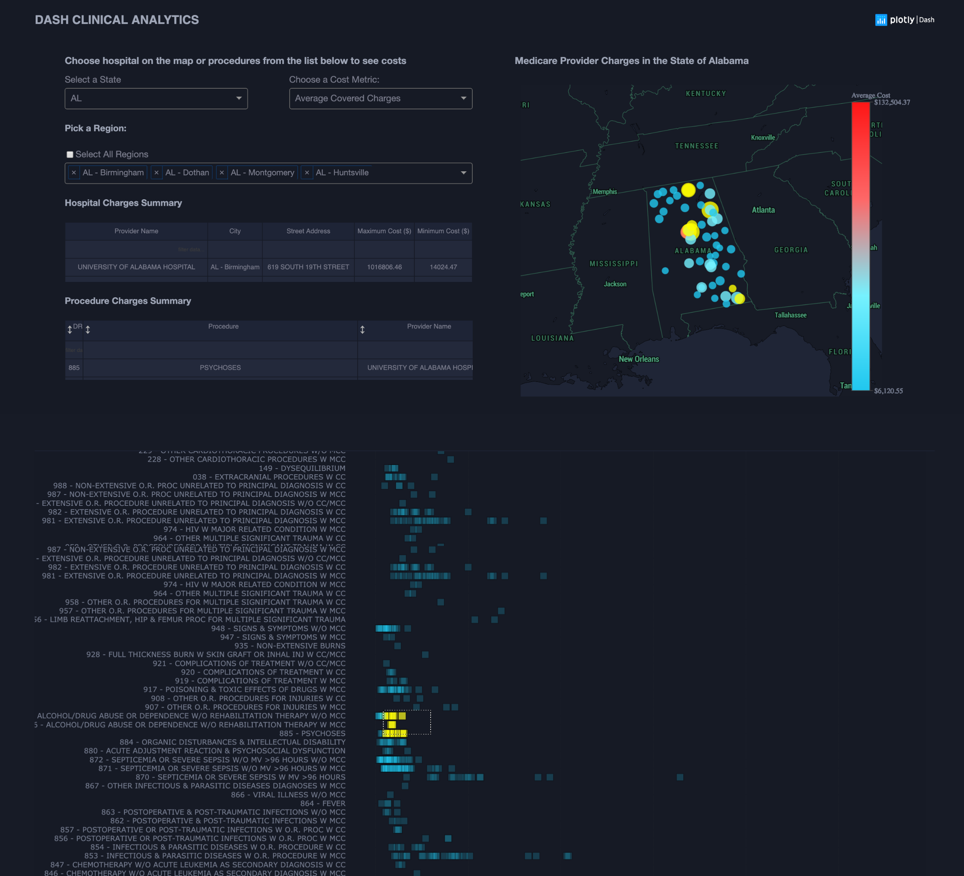
Large info screening - Dynamic Data tables

Slide 9
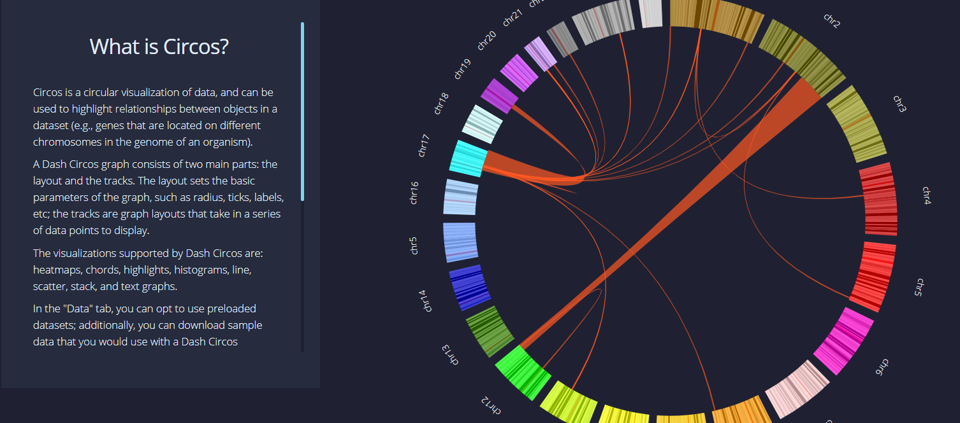
Circos

Slide 10
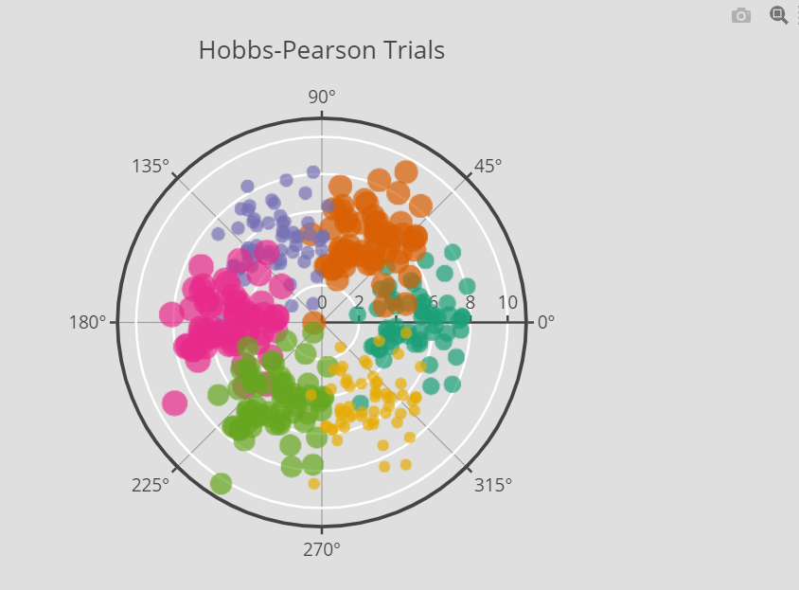
Radar Charts radarChart https://plotly.com/python/v3/polar-chart/2

Slide 11
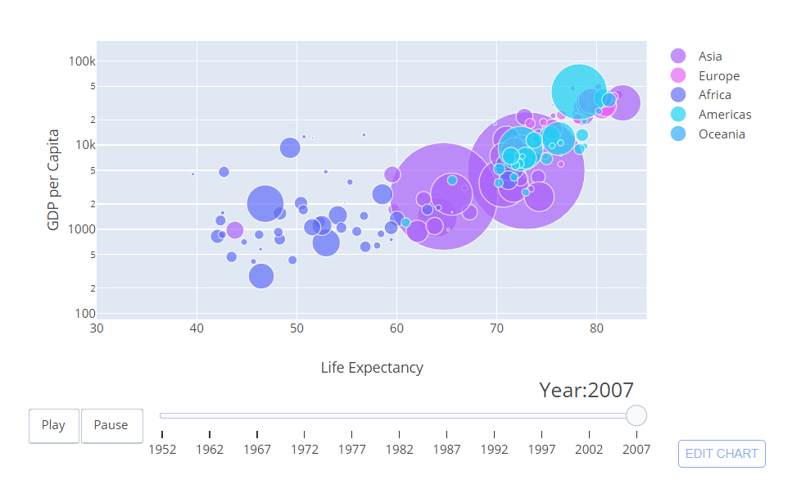
Animations - Plotly (not dash) - MRI (not dash) - Dash Solution??

Slide 12
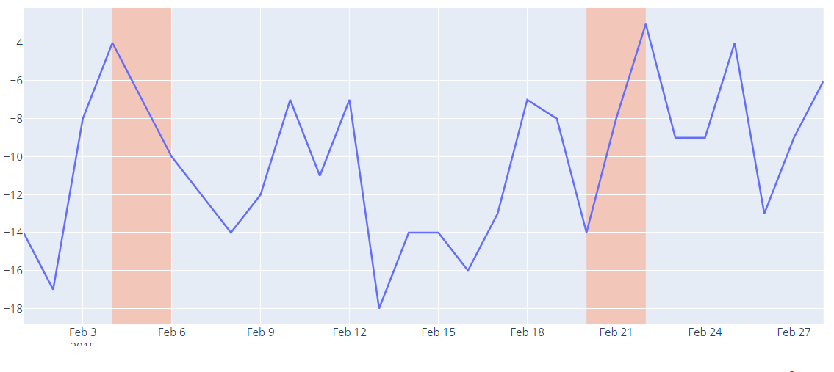
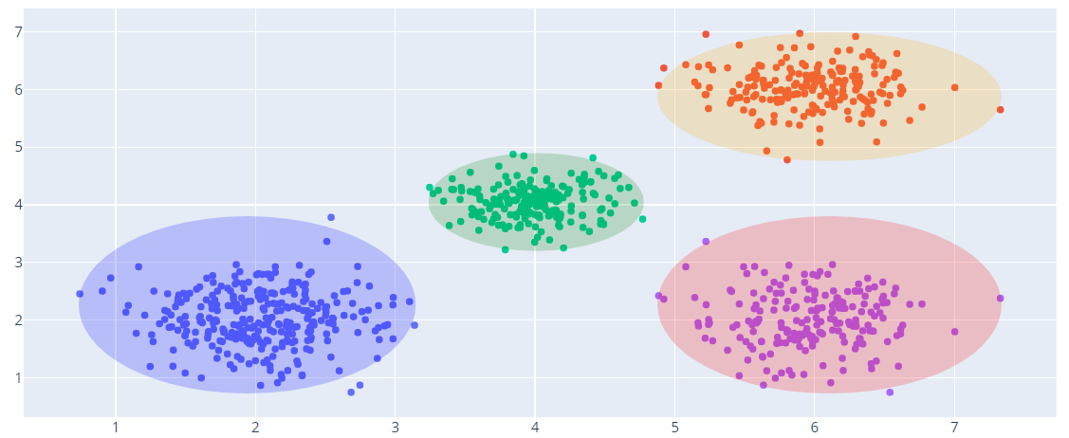
Plotly Shapes

Slide 13
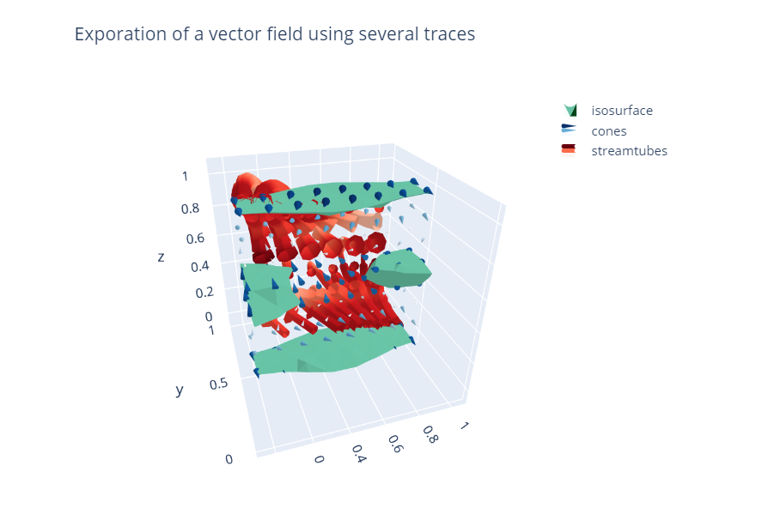
Legends 3D objects

